Slide 1
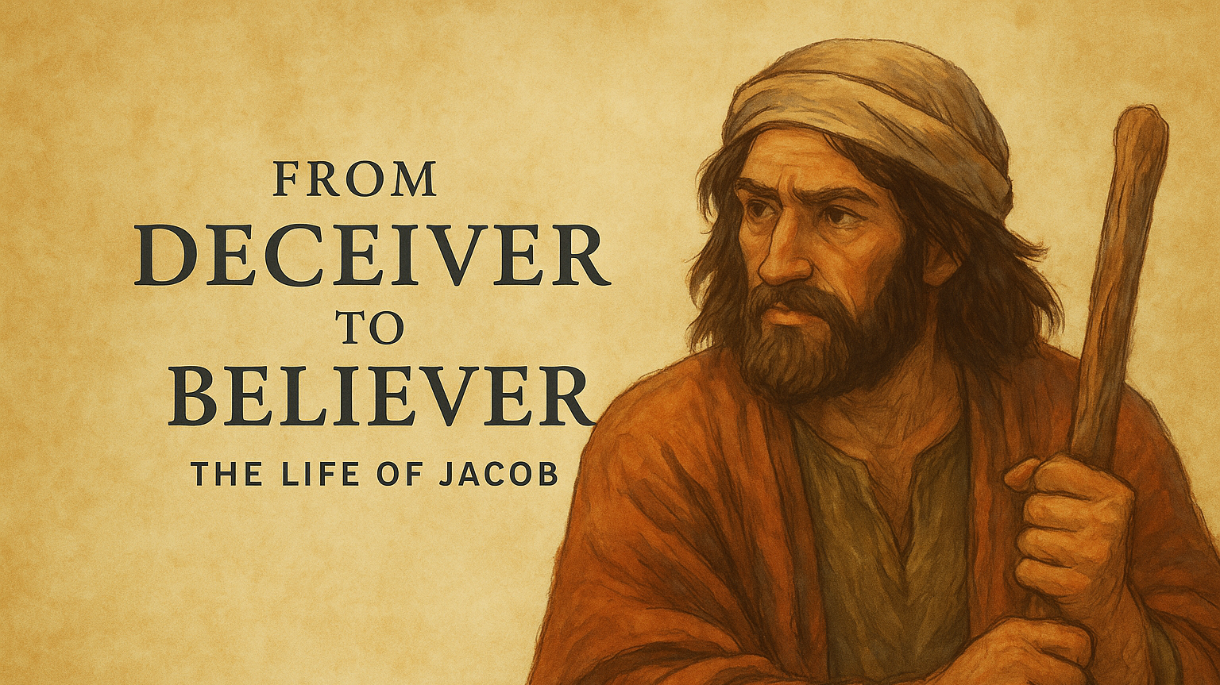

Slide 2
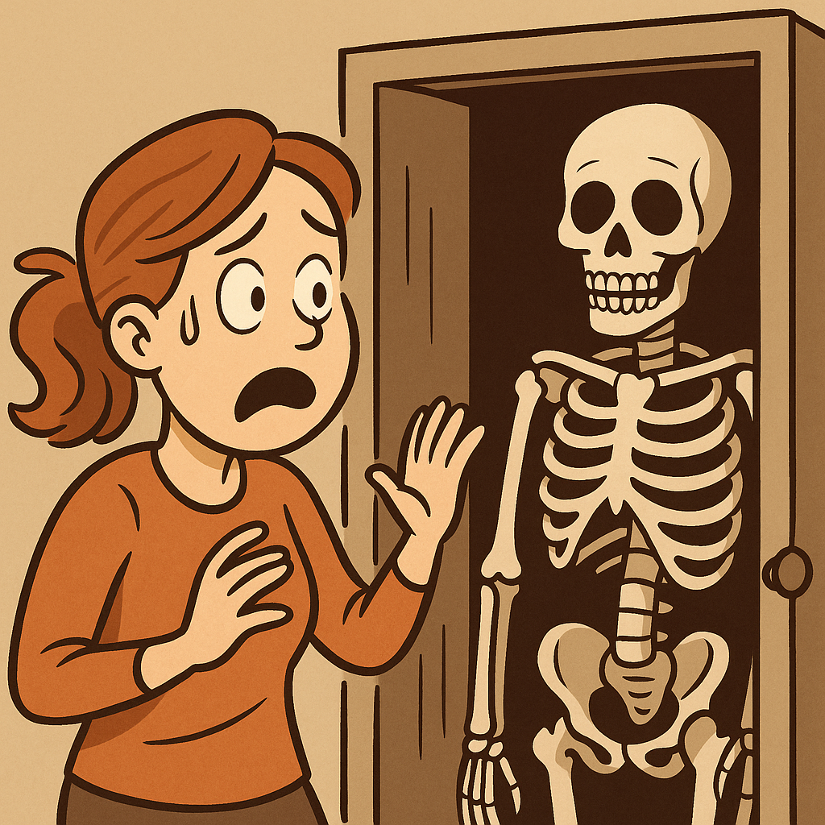

Slide 3

How We Commonly Respond to Fear
Behaviourally | Physically | Emotionally
Fight Flight Freeze Fawn Panic Denial | Increased heart rate Rapid breathing Sweating Trembling Dry Mouth Nausea | Anxiety Helplessness Anger/Irritability Shame Overwhelmed

Slide 4
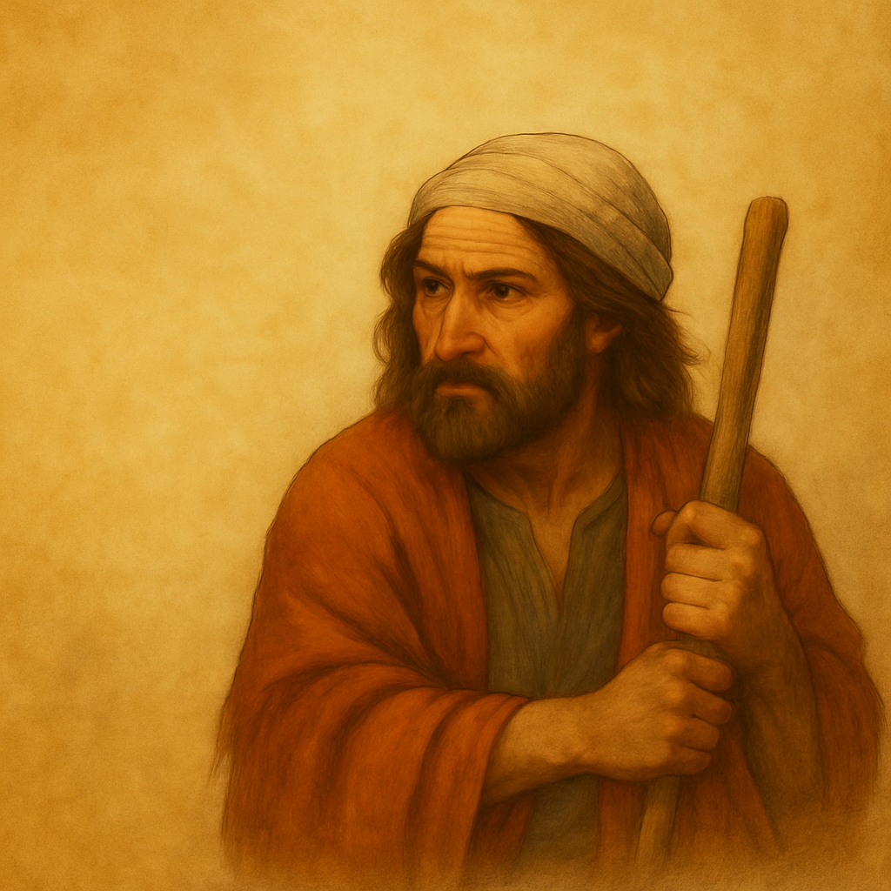
Facing Our Fears 32:1-1-21

Slide 5
Genesis 32
Jacob sees angels | 32:1-2
B. Jacob sends messengers to Esau - problem | 32:3-8
C. Jacob prays | 32:9-12
B’ Jacob sends servants to Esau - solution? | 32:13-21
A’ Jacob wrestles with God | 32:22-31

Slide 6
Three ways to face our fears each day

Slide 7
1. Recognise God’s presence and power
Genesis 32:1-2

Slide 8
Angels
Created beings (Colossians 1:16) Greater than humans in power (Hebrews 2:7) Can appear as humans (Hebrews 13:2) Involved in spiritual battles (Daniel 10:12-13) Serve God and do his will (Psalm 103:20, Luke 1:26-28) Minister to believers (Hebrews 1:14) They rejoice when sinners repent (Luke 15:10)

Slide 9
2. Request God’s help
Genesis 32:3-12

Slide 10
A Model Prayer
C - CALL on God’s name (v.9a) R - REMEMBER His promises (v.9b) A - ACKNOWLEDGE His goodness (v.10) B - BEG his help (v.11)
Adapted from Davis, God’s Rascal, pp. 84-85

Slide 11
3. Respond with faith-inspired wisdom
Genesis 32:13-21

Slide 12
Jacob’s Cunning Plan/Gift (aka Baldrick!)
What? | Assembles a substantial gift of over 550 animals, and arranges them to meet Esau in 3 different waves
Why? | To soften Esau’s anger toward him To remove the possibility of ambush To reduce Esau’s military readiness To slow Esau down To make Esau easier to detect To put his servants in Esau’s camp in case of a fight
Adapted from Davis, p.87

Slide 13
Jacob Reverting to Old (Esau?) Habits
The blessing meant Jacob would be lord over Esau, and Esau would be his servant (Genesis 27:29, 37) | But Jacob said to Esau, “Your servant Jacob…I am sending this message to my lord…” (Genesis 32:4-5, 18, 20)
The birthright meant Jacob would be the leader of the clan | But Jacob’s words to Esau show a willingness to renounce this leadership.
Jacob is willing to sell his blessing and birthright for his skin!

Slide 14
When faced with fear:
Recognise God’s presence and power
2. Request God’s help
3. Respond with faith and wisdom

Slide 15
BIG IDEA
Face fear with prayerful, practical faith

Slide 16
Facing Our Fears 32:1-1-21

