Slide 1
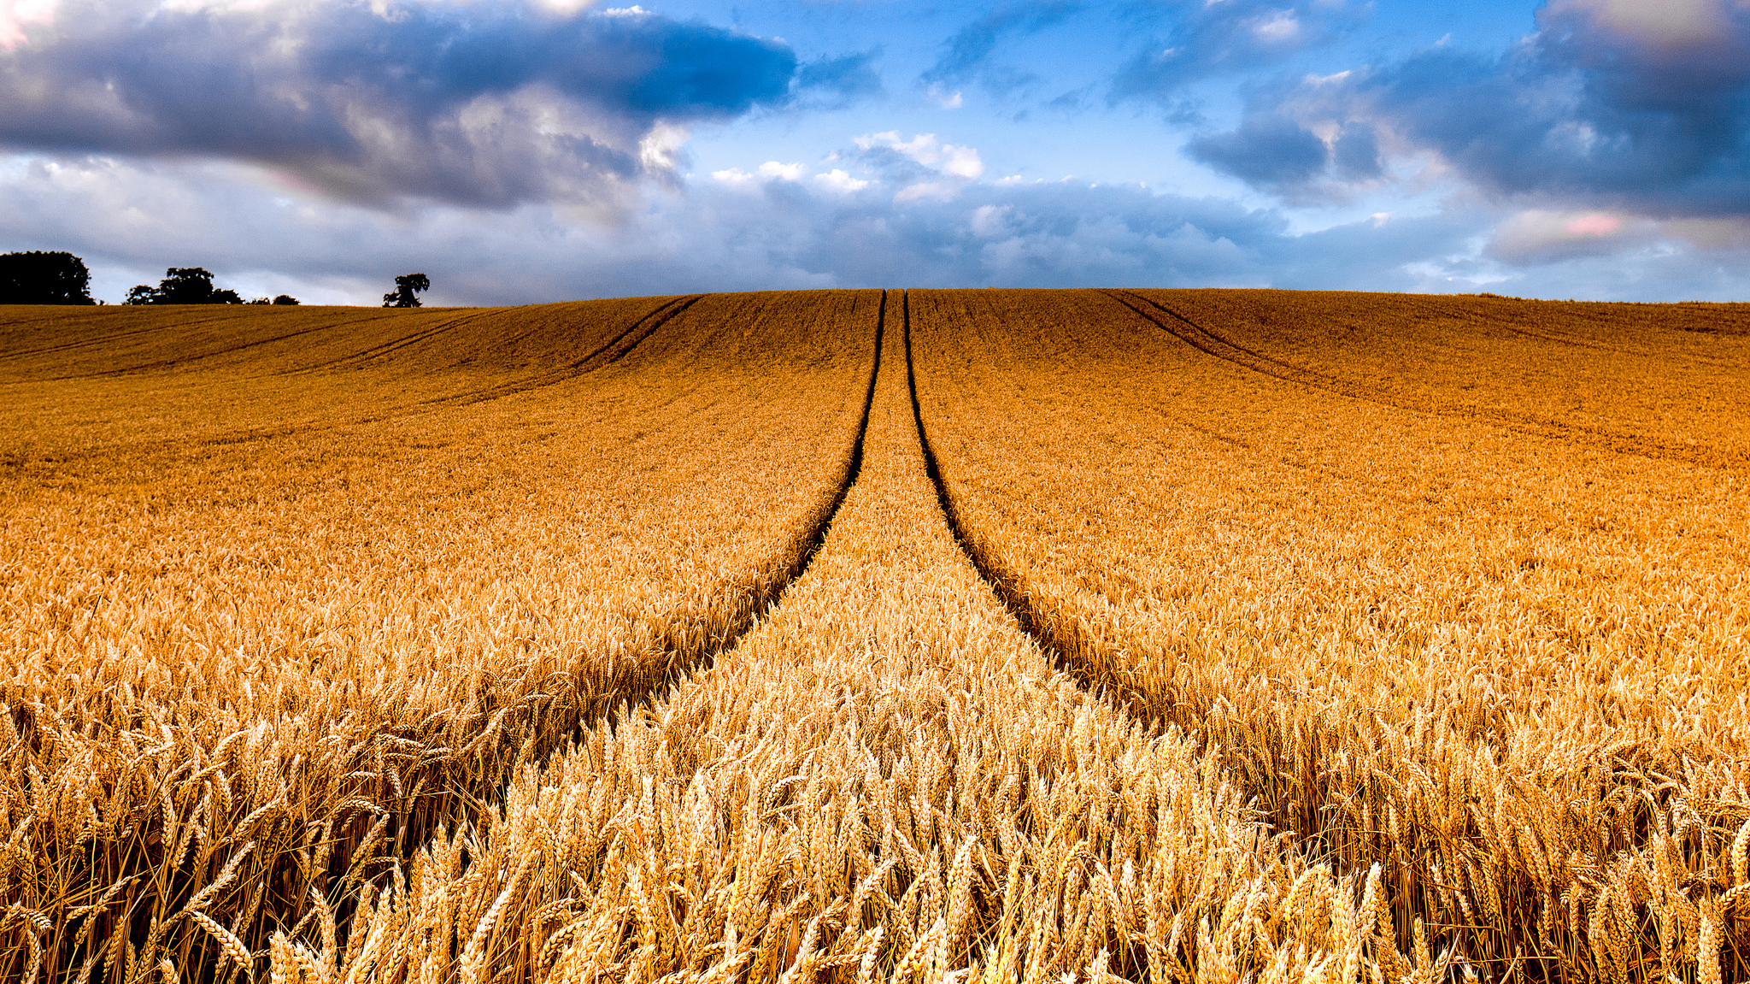
Let’s Get Going With The Gospel

Slide 2
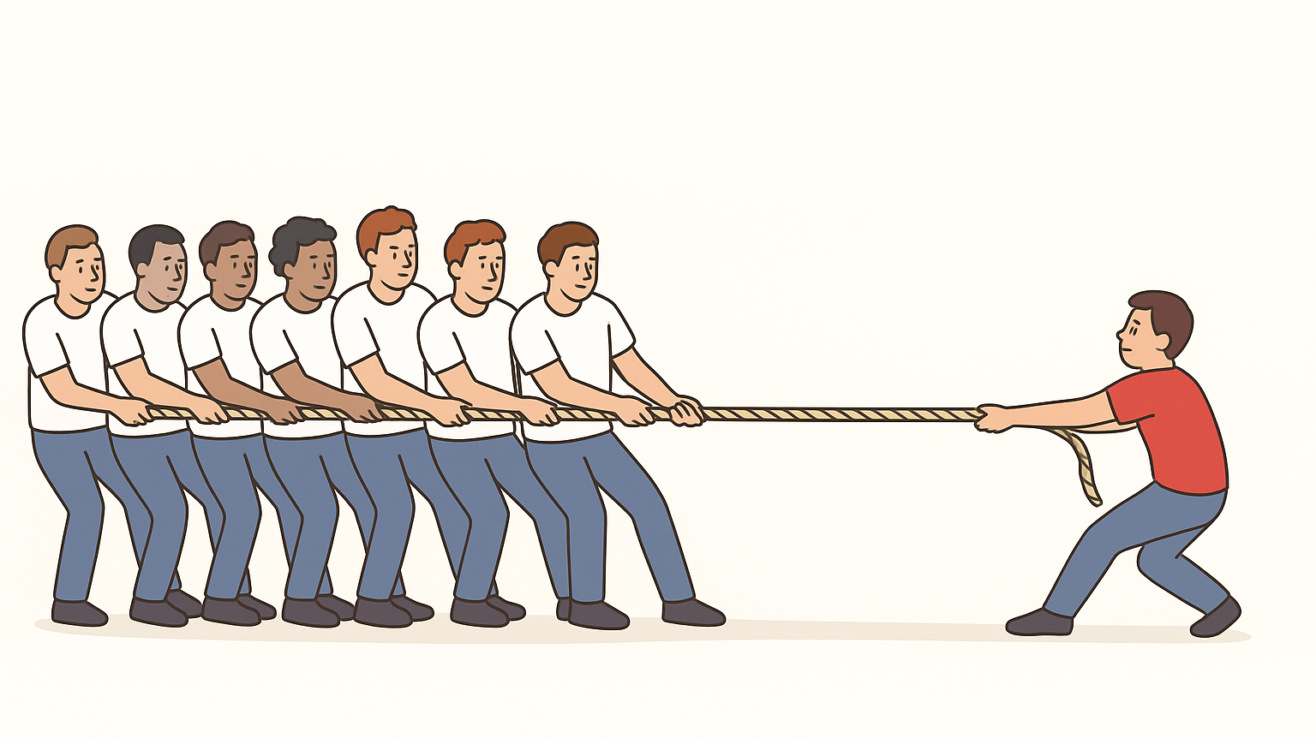

Slide 3
Let’s Get Going With The Gospel
It will take:
1. Coordination
2. Connection
3. Communication
4. Courage
5. Combat

Slide 4
Let’s Get Going With The Gospel
1. Coordination – Structure and Strategy

Slide 5
Let’s Get Going With The Gospel
1. God’s chosen structure to reach the world has always been believers organised in community.
- Israel in the O.T. - The Church now

Slide 6
Let’s Get Going With The Gospel
2. God’s chosen strategy to reach the world has always been believers modelling God’s love.
- Israel in the O.T. - The Church now

Slide 7
God’s O.T. Plan to Reach the World
Structure | The nation (community) of Israel | "It is too small a thing for you to be my servant to restore the tribes of Jacob and bring back those of Israel I have kept. I will also make you a light for the Gentiles, that my salvation may reach to the ends of the earth.“ (Isaiah 49:6, see also Gen 12:3)
Strategy | God’s people modelling God’s love | "May God be gracious to us and bless us and make his face shine on us— so that your ways may be known on earth, your salvation among all nations.“ (Psalm 67:1-2, see also Dt. 4:5-6)

Slide 8
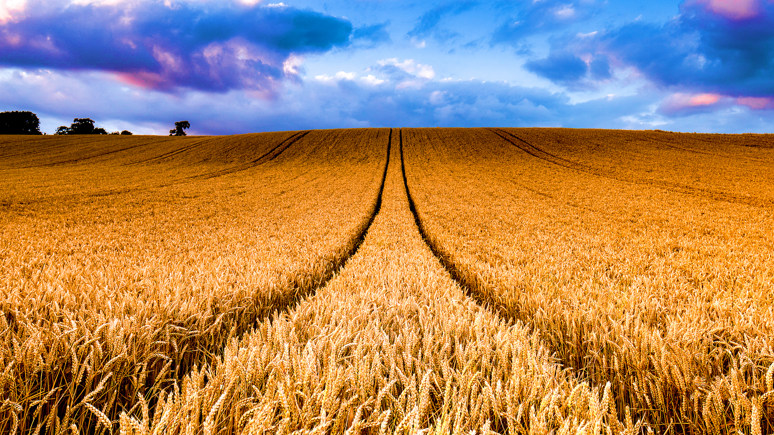
Joseph Aldrich, Life-Style Evangelism, p.34

Slide 9
Joseph Aldrich, Life-Style Evangelism, p.122

Slide 10
How the church becomes beautiful
Be devoted to one another (Rom 12:10)
Let us not judge one another (Rom 14:13)
Build one another up (Rom 14:19)
Be of the same mind with one another (Rom 15:5)
Accept one another (Rom 15:7)
Admonish one another (Rom 15:14)
Care for one another (1 Cor 12:25)
Serve one another (Gal 5:13)

Slide 11
How the church becomes beautiful
Bear one another’s burdens (Gal 6:2)
Be patient with one another (Eph 4:1-2)
Be kind to one another (Eph 4:32)
Be submissive to one another (Eph 5:18f)
Do not lie to one another (Col 3:9)
Forgive each other (Col 3:12-13)
Comfort one another (1 Th 4:18)
Encourage one another (Heb 3:13)

Slide 12
How the church becomes beautiful
Do not speak against one another (Jm 4:11)
Do not complain against one another (Jm 5:9)
Confess your sins to one another (Jm 5:16)
Pray for one another (Jm 5:16)
Be hospitable to one another (1 Pet 4:9)
Be humble toward one another (1 Pet 5:5)

Slide 13
How the church becomes beautiful
Love one another (Rom 13:8)
Increase in love for one another (1 Th 3:12)
Stimulate one another to love and good works (Heb 10:23-25)
Love one another (1 Pet 1:22)
Love one another (1 Jn 3:11)
Love one another (1 Jn 4:7)
Love one another (1 Jn 4:11)
Love one another (1 Jn 4:12)
Love one another (2 Jn 5)

Slide 14
How the church becomes beautiful
“A new commandment I give you: Love one another. As I have loved you, so you must love one another. By this shall all men will know that you are my disciples if you love one another.”
(Jesus, John 13:34-35)

Slide 15
To Win | To Lose
A strong anchor (Christ) Synchronisation and rhythm Mental toughness and endurance | Lack of coordination Poor footing or grip Burning out too quickly

Slide 16
Let’s Get Going With The Gospel
BIG IDEA: Be well-connected in the church so the world might know we are Jesus’ disciples.

