Slide 2
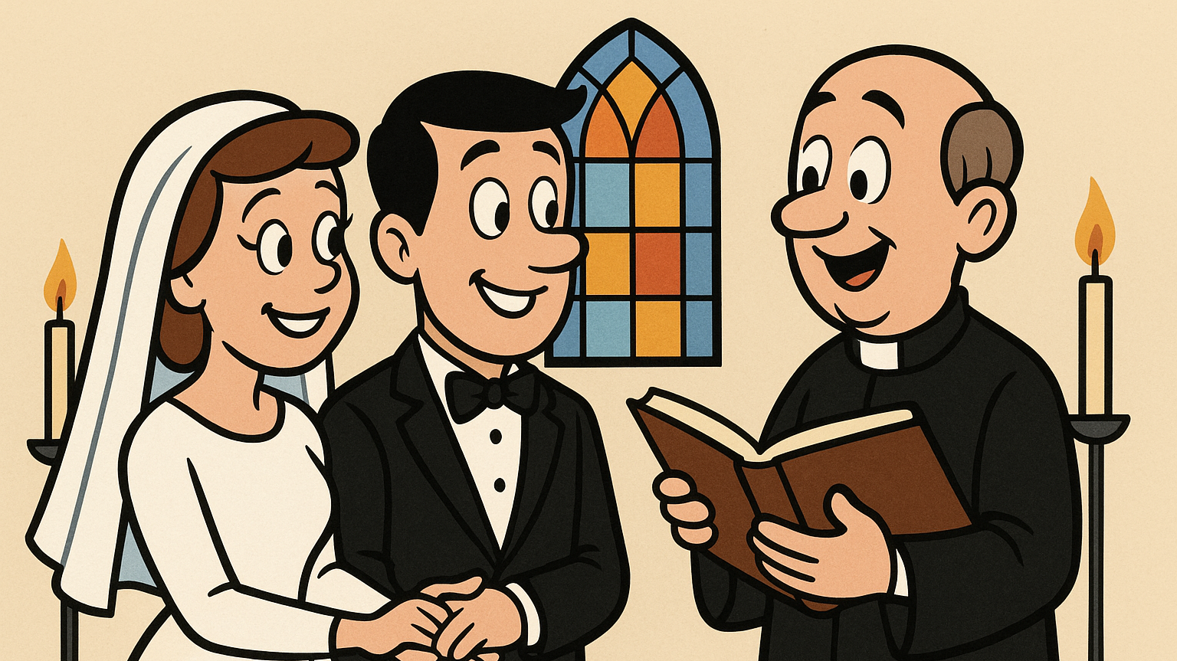

Slide 3
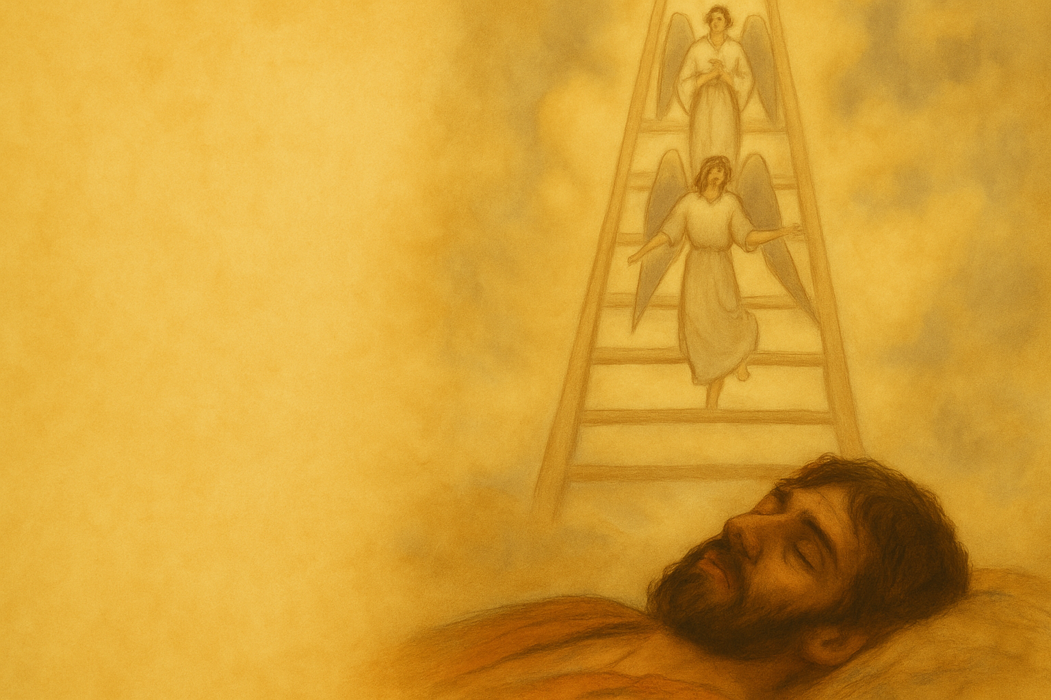
‘Getting’ Grace
Genesis 28:10-22

Slide 4
Jacob’s Wanderings
Jacob deceives Esau | Beersheba | 26:34-28:9
B. Angles of God and God meets Jacob | Bethel | 28:10-22
C. Jacob in exile | Padam Aram | 29-31
B’ Angels of God – God meets Jacob | Peniel | 32
A’ Jacob reconciles with Esau | Canaan | 33
Adapted from Kuruvilla, Genesis, p.331

Slide 5
Genesis 28:10-22
God’s Revelation | Action | 28:12-13a
 | Promise | 28:13b-15
Jacob’s Reaction | Action | 28:16-19
 | Promise/Oath | 28:20-22

Slide 6
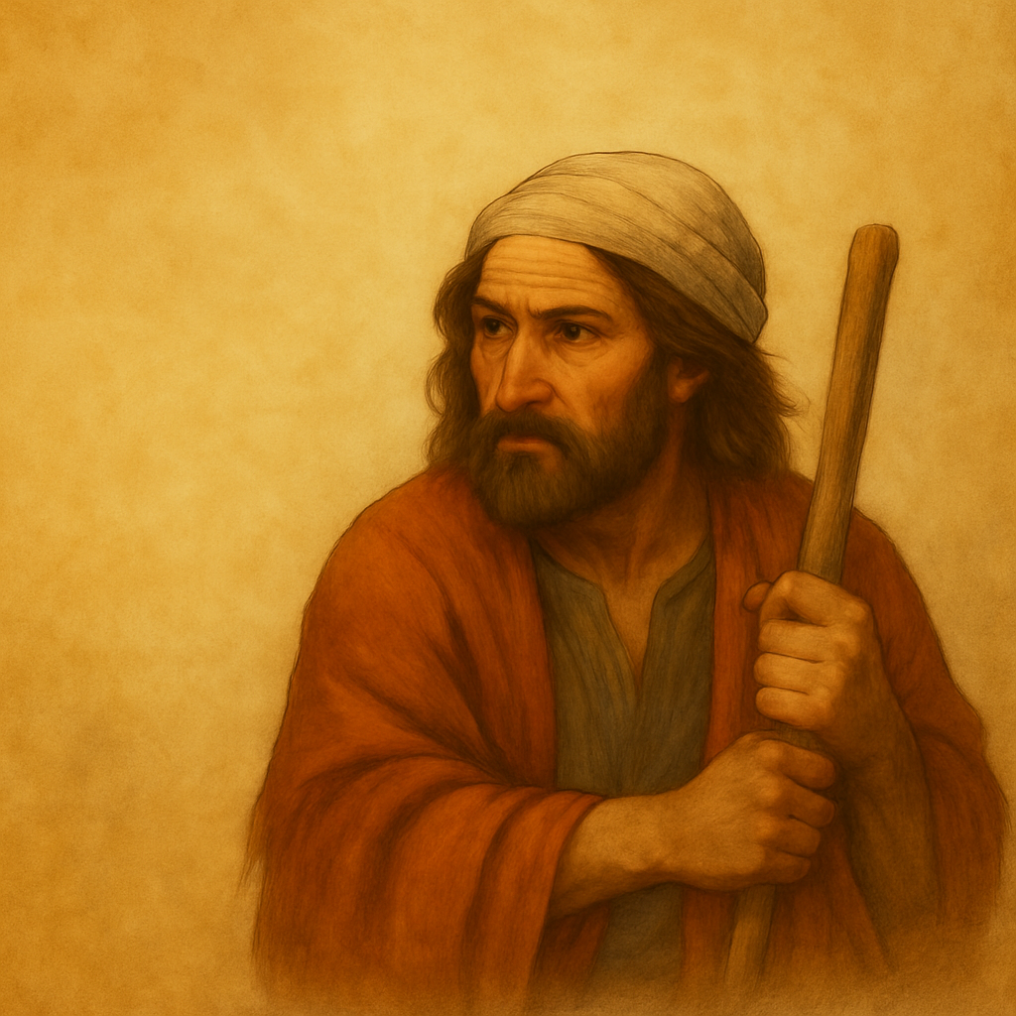
Four Aspects of God’s Grace

Slide 7
1. God’s grace amazes

Slide 8
“Behold!”; ladder to heavens | 28:12a
B. “Behold!”; angels of God | 28:12b
C. “Behold!”; Yahweh | 28:13a
D. Yahweh’s promises | 28:13b-15
C’ “Surely Yahweh is in this place” | 28:16
B’ “house of God” | 28:17b
A’ “gate of heaven” | 28:17c
Adapted from Kuruvilla, Genesis, p.335

Slide 9
2. God’s grace overflows

Slide 10
Promise | To Abram | To Isaac | To Jacob
Presence | I will be with you (15:1) | I will be with you (26:3) | I will be with you (28:15)
Place | The land (13:15) | these lands (26:3-4) | The land (28:13b)
People | Many descendants (12:2) | Many descendants (26:4) | Many descendants (28:14a)
Program | All nations blessed (12:3) | All nations blessed (26:4) | All nations blessed (28:14b)

Slide 11
The Believer’s Blessings
Every spiritual blessing (Eph 1:3) Forgiveness of sin (Eph 1:7) Justification by faith (Rom 5:1) Adoption as God’s children (Gal 4:4) Eternal life (Jn 17:3) Indwelling Holy Spirit (1 Cor 6:9) Access to God in prayer (Heb 4:16) Peace with God (Rom 5:1) Inheritance in Christ (1 Pet 1:4) Victory over sin (Rom 6:14)

Slide 12
3. God’s grace elicits worship

Slide 13
The Patriarchs at Worship
Abraham and altars | Shechem Hebron Mount Moriah | 12:7 13:14-18 22:1-2, 9
Isaac and altars | Beersheba | 26:2, 24-25
Jacob and altars | Bethel | 28:10-22

Slide 14
4. God’s grace transforms

Slide 15
Jacob’s Transformation by Grace
(to Isaac) “Your God” | Gen 27:20
“Surely the Lord is in this place” | Gen 28:16
“The God of my father” | Gen 31:5
“The God of Abraham and Isaac” | Gen 31:42, 32:9-12
“I have seen God face to face” | Gen 32:24-30
The God of Israel | Gen 33:20
The God who has been my shepherd | Gen 48:15-16

Slide 16
Jacob’s Wanderings
Jacob deceives Esau | Beersheba | 26:34-28:9
B. Angles of God and God meets Jacob | Bethel | 28:10-22
C. Jacob in exile | Padam Aram | 29-31
B’ Angels of God – God meets Jacob | Peniel | 32
A’ Jacob reconciles with Esau | Canaan | 33
Adapted from Kuruvilla, Genesis, p.331

Slide 17
Paul | Nicodemus | Pilate
Immediate transformation | Gradual transformation | No transformation
Acts 9 | John 3, 7, 19 | John 18

Slide 18
BIG IDEA
Be transformed by the grace of God

Slide 19
‘Getting’ Grace
Genesis 28:10-22

