Slide 1
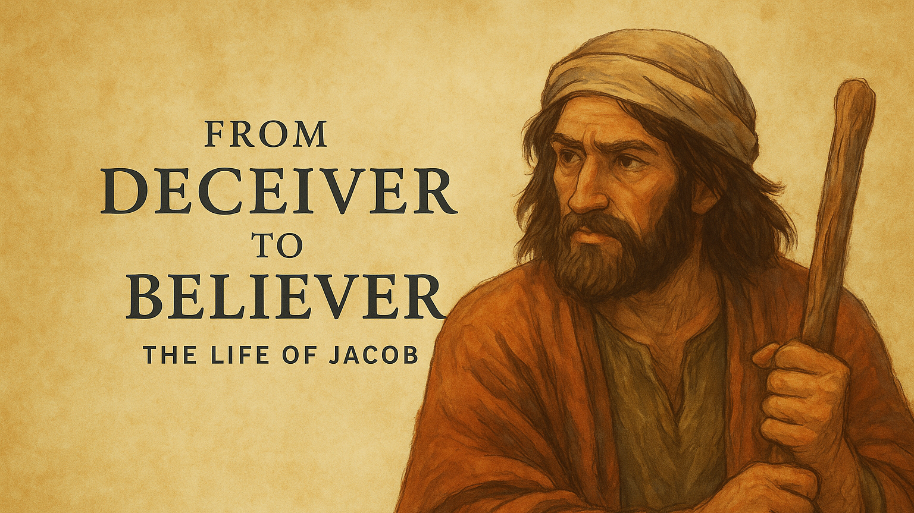

Slide 2





Slide 3
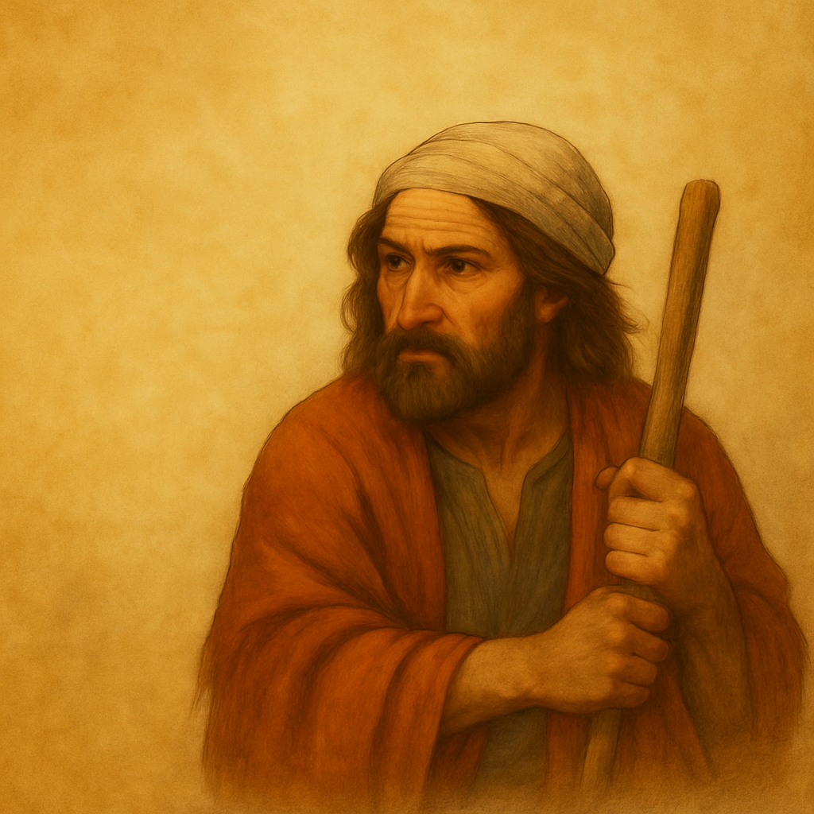
Compromise, Corruption, Cowardice
Genesis 34

Slide 4

Genesis 34
Crime (34:1-4) - ‘Dinah violated’ (34:2)
2. Deceitful Plots (34:5-24)
3. Crimes (34:25-29)
4. Justification (34:30-31) - ‘Dinah violated’ (34:31)

Slide 5
Deceitful and Despicable Negotiations
Hamor & Shechem | Jacob’s Boys
Have no remorse Hold Dinah hostage (34:26) Misrepresent the deal to their people (or to Jacob’s boys) Are greedy for gain (34:23) | Are deceitful (34:13) Desecrate the covenant sign (Gen 17) Are greedy for gain (34:26-29)

Slide 6
Poetic Justice
Dinah was ‘taken’ (34:2), so… Simeon and Levi ‘take’ swords (34:25) Simeon and Levi ‘take’ Dinah (34:26) The boys ‘take’ the town’s booty (34:28)
Adapted from Kuruvilla, Genesis, p.426

Slide 7
Ugly Irony
“The ironic outcome is that, to avenge the taking of a woman by force, the sons of Jacob do exactly that themselves, rounding up all the town’s women after killing their husbands (34:29)”
Kuruvilla, Genesis, p.427

Slide 8
When God is Left Out
The villains in this story (almost everyone!): Shechem’s disgraceful act against Dinah (34:2,7) Hamor’s deceitful negotiations (34:26) Jacob’s sons’ heinous crimes (34:25-29) | Toxic Masculinity
4. Jacob’s incredibly poor, apathetic leadership | Passive Masculinity

Slide 9
Three threats to our witness

Slide 10
1. Worldliness threatens our witness – resist it

Slide 11
Don’t make treaties with or marry the Canaanites
`Exodus 34:11-16 Deuteronomy 7:1-6
Positive Examples | Negative Examples
No Canaanite wife for Issac (Gen 24:3) No Canaanite wife for Jacob (Gen 28:1) | Esau’s Canaanite wives caused grief (26:34-35) Judah’s Canaanite wife (Gen 38)

Slide 12
Resist Worldliness
2 Corinthians 6:14-18
Be careful where you go Be careful who you marry Be careful who you partner with in business

Slide 13
2. Wickedness threatens our witness – reject it

Slide 14
The Wickedness of the Covenant People
Desecration Deceit Murder Theft Kidnapping Intermarriage

Slide 15
Reject Wickedness
Ephesians 5:11
Reject anything morally corrupt Reject anything morally dubious

Slide 16
3. Want of leadership threatens our witness – remedy it

Slide 17
Jacob’s Negligence as a Dad
First, Dinah is the daughter of Leah, the wife Jacob disliked (34:1) Second, Dinah is Jacob’s daughter (34:1, 3, 5, 7) Third, Dinah is Simeon and Levi’s sister (34:13, 14, 17, 31)
Contrast Jacob’s passivity with Hamor’s aggressive negotiating on behalf of his son (though both fathers indulge their sons). Contrast Jacob’s lack of outrage with his grief over Jospeh in 37:34-35
Adapted from Kuruvilla, Genesis, p.421-422

Slide 18
When Guardians Don’t Guard
Victim | Perpetrator(s) | Negligent Guardian | Passage
Dinah | Shechem | Jacob | Gen 34
A Concubine | Men of Gibeah | A Levite | Judges 19
Tamar | Ammon | King David | 2 Sam 13
Bathsheba | King David | King David | 2 Sam 12

Slide 19
Jacob’s Negligence as a Leader
His first words come at the end of the episode (34:30) He exhibits no grief (or joy at Dinah’s rescue) He demands no justice or recompense He gives no spiritual guidance His concern is self-focused; his standing among the Canaanites He uses the personal pronoun 8 times in 16 Hebrew words (NIV 6 times) He singles out Simeon and Levi for criticism, not the others (see 49:5-7)
Adapted from Kuruvilla, Genesis, p.427-428

Slide 20
Remedy the Want of Godly Leadership
Men, don’t indulge your children Men, fight for the honour and virtue of those in your household Men, give spiritual leadership to your household Men, show your household, by your actions and habits, how important God is to you

Slide 21
Three threats to our witness:
Worldliness
2. Wickedness
3. Want of Leadership

Slide 22
BIG IDEA
Godly leadership defends against worldly wickedness

Slide 23
Compromise, Corruption, Cowardice
Genesis 34

